Slide 1
CampusPilot AI
AI-Powered Accessible Campus Navigation
An AI-powered campus navigation assistant that helps every visitor reach the right destination — quickly, intelligently, and accessibly.
Team Composition
Name
Role
Programme
Year
Anshul Kumaria
AI & Intelligence Lead
B.Tech CSE
3rd Year
Dhruv Sarda
Core Solution Architecture Lead
B.Tech CSE
3rd Year
Hrishikesh Kali
Implementation & Feasibility Lead
B.Tech CSE
3rd Year
Atharva Deshmukh
Research & Lit. Review Lead
B.Tech CSE
3rd Year
Rishabh Alekar
Problem Analysis Lead
B.Tech CSE
3rd Year

Slide 2
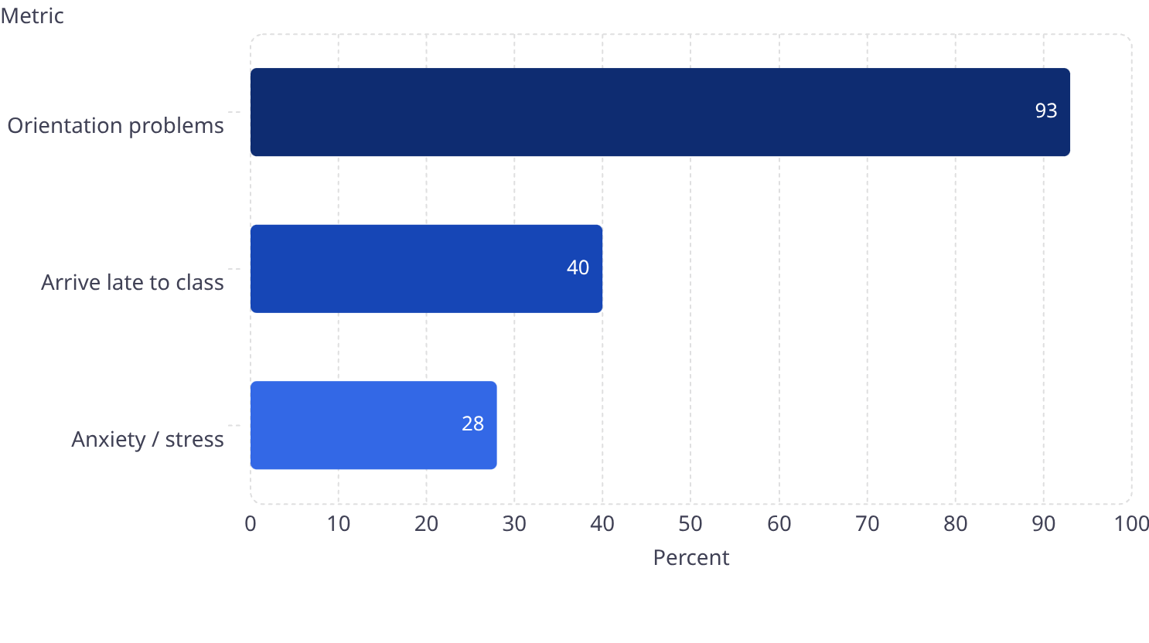
The Business Challenge
Campus navigation fails everyone — but fails disabled students completely. The gap between what navigation tools promise and what users actually experience is enormous — and measurable.
93%
40%
330+
46%
Orientation Problems
Arrive Late to Class
Registered Disabilities
App Uninstall Rate
Students report difficulty navigating campus — Evelity survey, 300 students across 107 campuses (2025)
Directly caused by navigation failure — same Evelity 2025 survey
On a 15,000-student campus — real need is 2–3× higher (MoSPI 2021)
Android apps abandoned within 30 days of install — AppsFlyer 2025 benchmark
Current Situation
Existing App Issues - By The Numbers
Current Reality
What's Needed
GPS fails indoors
Reliable indoor positioning
Accessibility is incomplete
Disability-aware routing
Maps ignore real-time constraints
Live campus context
Apps depend on internet
Offline & low-connectivity support

Slide 3
Proposed Solution
CampusPilot AI is a conversational AI agent that knows where users are indoors, routes around real constraints, serves every disability profile, and works even when the internet doesn't.
QR Indoor Positioning
Conversational Navigation
Accessibility Intelligence
Precise indoor location from QR checkpoints placed at entrances, lifts, and corridor junctions — no GPS, no beacons, no power dependency, fully offline.
Natural language queries understood by an LLM agent — intent, location, and constraints resolved in one exchange.
Five disability profiles: wheelchair, vision-impaired, hearing-impaired, cognitive, and invisible. WCAG 2.1 compliant.
Shadow Mapping
Bluetooth Mesh
Official map + real-usage map. Micro-feedback continuously corrects inaccurate campus data automatically.
Every phone is a data node. Crowd alerts and emergency signals travel device-to-device without internet.
How We Are Different
Capability
Existing Apps
CampusPilot AI
Indoor navigation
Limited or GPS-dependent
QR-based indoor positioning
Disability coverage
Usually 1–2 profiles
5 disability profiles
Real-time updates
Limited or community-based
Shadow map + live feedback
Offline support
Weak or unavailable
QR + caching + Bluetooth mesh
Conversational AI
Mostly absent
Natural language route assistant
Emergency support
Basic or missing
SOS via mesh + SMS + QR location
Benchmarked against GoodMaps, Wheelmap, BlindSquare, and AccessNow.

Slide 4




Innovation Story
Three non-obvious decisions forced by real campus constraints
We Rejected the Obvious Answer
We Solved for When Infrastructure Fails
We Designed for Who Actually Needs This
Constraint: GPS fails indoors. 46% of nav apps are uninstalled in 30 days.
Constraint: Campus WiFi saturates during events — exactly when navigation matters most.
Constraint: Existing tools treat disability as binary. Most cover only wheelchair users.
Decision: Build a conversational agent + QR positioning at ₹20/point — no hardware, no install barrier.
Decision: Five profiles built into the architecture — each with unique routing logic and interaction mode.
Decision: Bluetooth mesh + shadow mapping. The system improves as usage grows.
Outcome: Indoor location becomes solvable at campus scale, cheaply.
Outcome: No competitor covers more than two disability categories.
Outcome: Performs best when WiFi performs worst.
50%
100%
80%+
Faster Navigation
Disability Coverage
Adoption Potential
10–15 min per destination → under 2 min with the conversational agent
All five categories with distinct interaction modes — no competitor matches this
88% of students want a wayfinding app; zero-install PWA eliminates the 46% uninstall risk
"We didn't build a better map. We made three non-obvious decisions forced by real constraints — and they compounded into a campus navigation intelligence layer no existing product has reached."

Slide 5

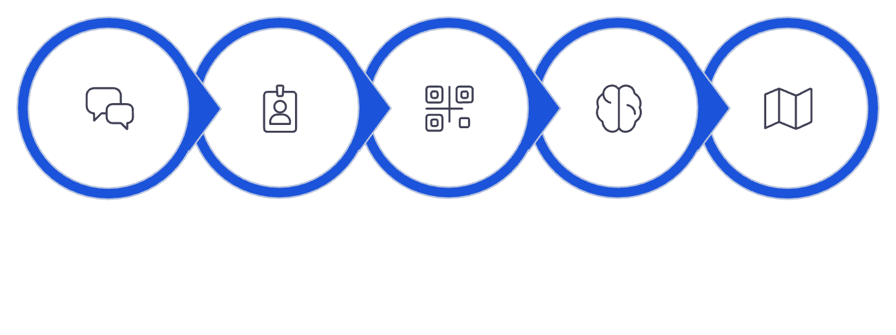






Execution Approach
A disciplined four-phase build — from raw campus data to a fully tested, accessibility-compliant navigation intelligence layer.
Agent Development
Testing & Evaluation
Data & Mapping
Navigation Intelligence
LLM agent, FastAPI backend, routing
Route accuracy, WCAG, offline reliability
Floor plans, Neo4j graph, QR rollout
Shadow map, Bluetooth mesh, offline SOS
Demo Flow
Evaluation Mapping
Criterion
CampusPilot AI Solution
Route correctness
Knowledge graph + golden dataset testing
Accessibility options
5 disability profiles + WCAG 2.1
Profile Detect
Route Reasoning
Deliver Route
Conversation UX
Natural language via Claude + LangChain
User Query
Scan QR
Context handling
Shadow map + admin-flagged updates
Tech Stack: Claude API · LangChain · FastAPI · Neo4j · React PWA · Google Nearby Connections · OpenTelemetry
Offline / low connectivity
Mesh network + progressive caching

